Slide 1

ROAD TRAFFIC ACCIDENT OVERVIEW
By
Ifeoma Orajiaka

Slide 2
Reducing Road Accidents Analysis of Hotspots and Safety Recommendations
PROJECT OBJECTIVE
To clean, analyze, and visualize road accident data using Excel
To uncover insights from raw accident datasets through statistical analysis and interactive dashboards
To identify key risk factors influencing accident severity.
To deliver data-driven recommendations for enhancing road safety policies and infrastructure.

Slide 3
The Problem at Hand
Road accidents continue to pose a serious public safety threat.
However, accident data is often unstructured, making it hard for authorities to:
Understand key risk factors.
Prioritize interventions.
Identify accident hotspots.
There is an urgent need for a systematic, visual, and statistical approach to analyze these accidents and recommend actionable improvements.

Slide 4
OUR ANALYTICAL JOURNEY
Road traffic accidents are widespread, influenced by factors like road condition, speed, light, and weather. Data exists but is unstructured and underutilized.
We used statistical tools and data visualization to derive meaningful insights from the accident data
- We cleaned and standardized data from Excel for 2021-2022
- We performed statistical analysis (mean, median, standard deviation)
- We built an interactive dashboard with filters and charts analysis
- Clear understanding of accident patterns.
- Identified key contributors to accident severity.
- Provided strategic recommendations for policy and infrastructure enhancements.

Slide 5
Data-Driven Decision Making
Helps authorities make evidence-based interventions
Addressing Safety Challenges
Uncovers critical patterns behind accident severity
Why This Project Matters
Better Road Safety Policies
Supports design of smarter, safer road networks
Optimized Resource Allocation
Targets high-risk areas for more efficient funding and efforts

Slide 6
Key Finding
Total Accidents (2021-2022)
308,000
Total Casualties (2021-2022) 417,900
There was an 11% decrease in both accident and vehicles from 2021 to 2022
Accidents are concentrated around urban roads, 30mph limits, and T-junctions.
Birmingham records the highest number of casualties (8.6K) among all local authorities.

Slide 7
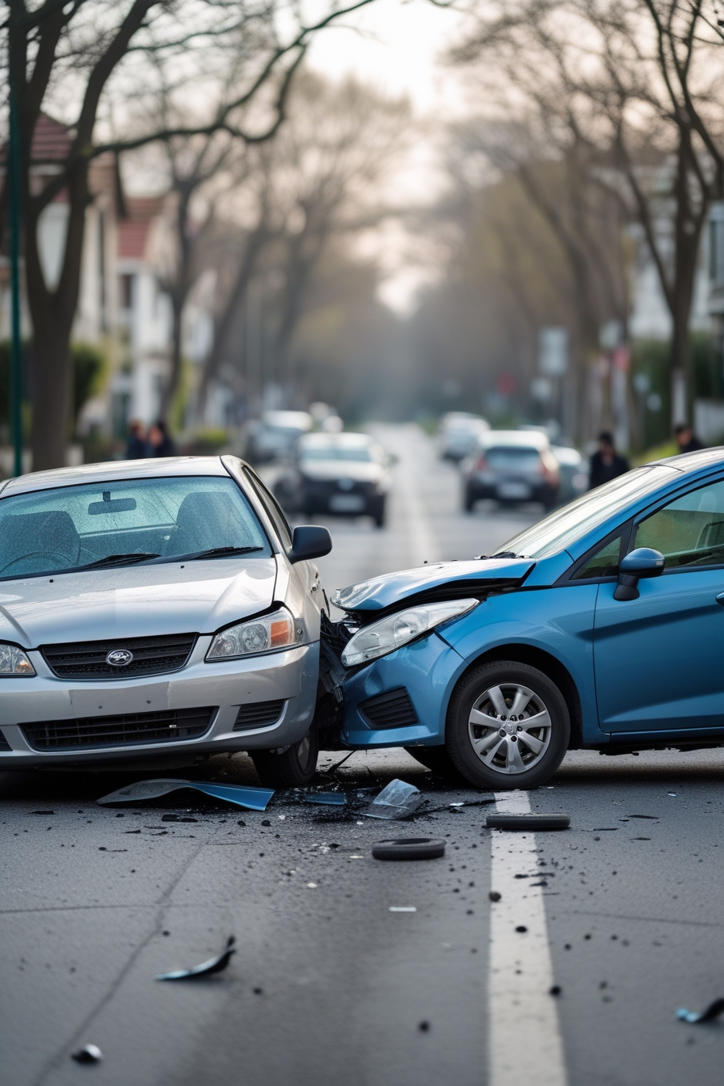
Key Accident Hotspots Identified
By Location Type
Urban Areas: 198.5k accidents
Rural Areas: 109.4k accidents
By Speed Limit
30 mph Roads: 200k accidents
By Road Type
Single Carriageways: 309.7k casualties (dominant hotspot)
T-Junctions / Staggered Junctions: 96.7k accidents
Give Way/Uncontrolled Junctions: 150k accidents

Slide 8
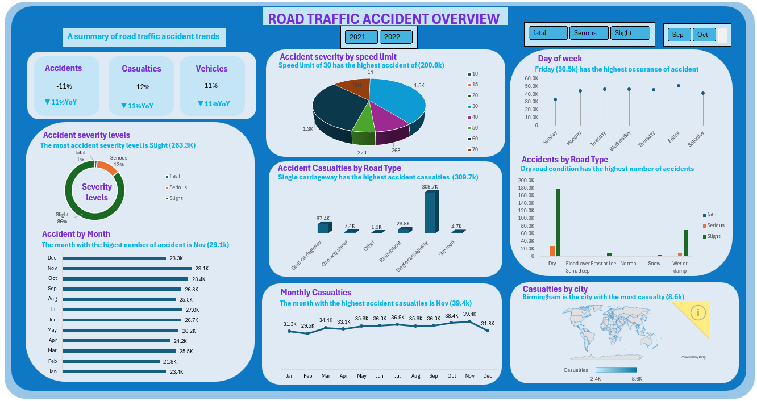

Slide 9
Time & Environmental Risk Factors
Time of Year / Week / Day
Month: November (Peak month - 29.1k accidents, 39.4k casualties)
Day: Friday (Highest frequency - 50.5k)
Time: 3 PM – 6 PM (Peak accident hours)
Environmental Conditions
Road Conditions: Dry roads (209k accidents)
Light Conditions: Daylight (227.3k accidents)
Weather: Fine weather without high winds (244.5k accidents)

Slide 10
Severity Breakdown
Accident Severity
Fatal 1%
Serious 13%
Slight 85%
Most accidents result in slight injuries.
Severe cases correlate strongly with junctions and road types.
Notes:
All these are shown clearly on the dashboad

Slide 11
Descriptive Statistics of Key Variables
To understand the typical accident profile, we computed the Mean, Median, and Standard Deviation for the key variables related to vehicles, casualties, and speed limits.
Variables | Mean | Median | Std. Deviation
Number of Vehicles | 1.83 | 2 | 0.71
Casualties | 1.36 | 1 | 0.82
Speed Limit | 38.87 | 30 | 14.03

Slide 12
Key insights
Most accidents involve 1 to 2 vehicles
The typical accident results in 1 casualty
The average speed limit where accidents occur is 39 mph, but the spread is wide (Std Dev = 14 mph)

Slide 13

Recommendations — Infrastructure
Target Problem Areas
Single Carriageways rumble strips
Clear markings, traffic calming
T-Junctions / Staggered Signal control
Improved signage
Redesign 30mph Urban Zones
Speed bumps
Raised crossings
Stricter enforcement
Give-Way Junctions
Evaluate for potential upgrades to traffic lights.

Slide 14
Recommendations — Policy & Enforcement
Policy Actions
Expand 30mph enforcement through cameras
Mandate junction safety reviews in urban planning
Schedule increased enforcement during peak accident times (Friday afternoons)
Data-Driven Enforcement
Prioritize known hotspots
Coordinate with local councils and police for targeted operations

Slide 15
Recommendations — Public Awareness
Key Campaign Messages
Urban Driving at 30mph: "Even slow speeds kill."
Junction Awareness: "Expect the unexpected at intersections."
Friday Fatigue: "End your week safely."
Complacency in Daylight: "Visibility isn’t immunity."

Slide 16
Conclusion
"Safer Roads Require Smarter Data-Driven Action." Addressing hotspots through a combination of policy, infrastructure, and education will reduce accidents and save lives.

Slide 17

Thank you

